Slide 1
Housing Project

Slide 2
Introduction
Houses are one of the necessary need of each and every person around the globe and therefore housing and real estate market is one of the markets which is one of the major contributors in the world’s economy. It is a very large market and there are various companies working in the domain. Data science comes as a very important tool to solve problems in the domain to help the companies increase their overall revenue, profits, improving their marketing strategies and focusing on changing trends in house sales and purchases. Predictive modeling, Market mix modeling, recommendation systems are some of the machine learning techniques used for achieving the business goals for housing companies. Our problem is related to one such housing company.

Slide 3
Problem Statement
The company is looking at prospective properties to buy houses to enter the market. You are required to build a model using Machine Learning in order to predict the actual value of the prospective properties and decide whether to invest in them or not. For this company wants to know:
• Which variables are important to predict the price of variable?
• How do these variables describe the price of the house?
You are required to model the price of houses with the available independent variables. This model will then be used by the management to understand how exactly the prices vary with the variables. They can accordingly manipulate the strategy of the firm and concentrate on areas that will yield high returns. Further, the model will be a good way for the management to understand the pricing dynamics of a new market

Slide 4
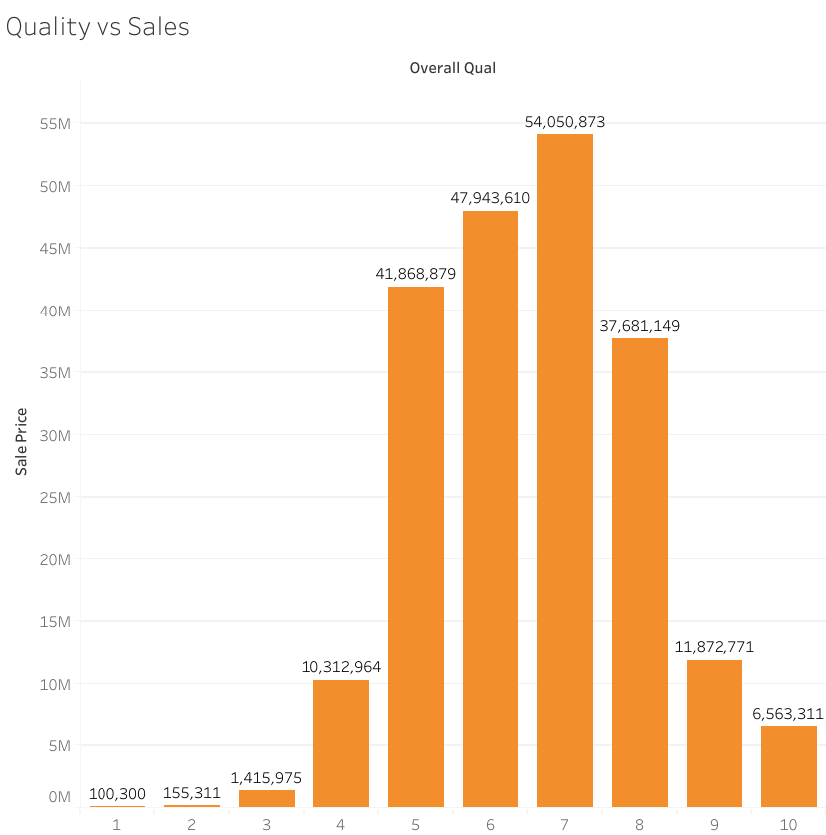
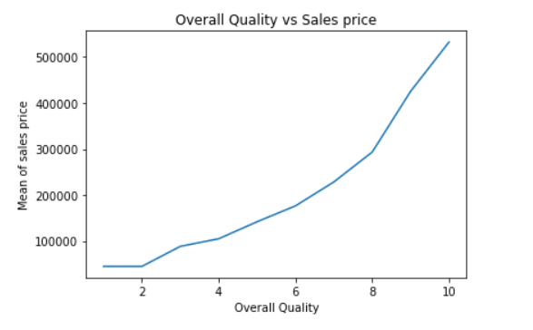
EXPLORATORY DATA ANALYSIS
In this given dataset there are 81 columns or parameters, We mainly focused on what are the parameters which decides the sales price, There are 35 parameters out of all which has got a significant effect over deciding the sales price.
Sl.no Quality Range
1 Very poor 30k to 60k
2 Poor 30k to 60k
3 Fair 38k to 139k
4 Below Average 34k to 176k
5 Average 55k to 229k
6 Above average 76k to 277k
7 Good 116k to 341k
8 Very Good 147k to 440k
9 Excellent 239k to 612k
10 Very Excellent 310k to 755k

Slide 5
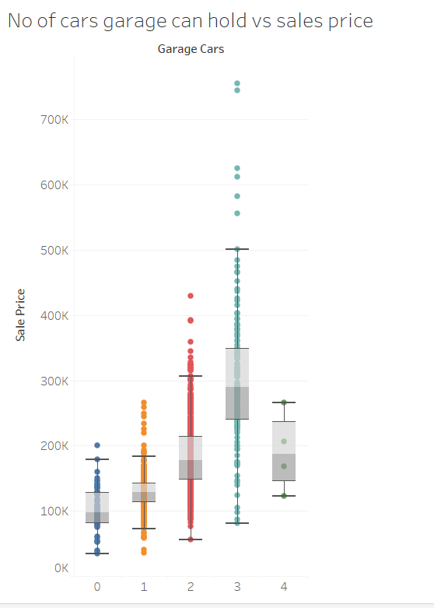
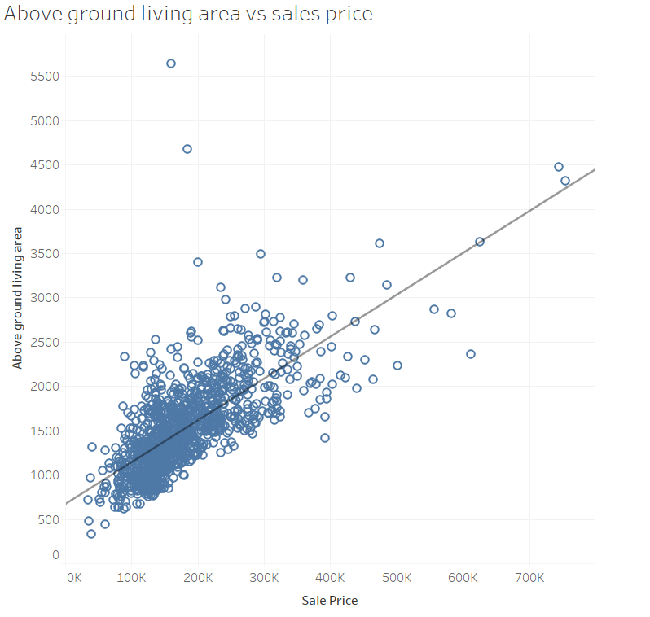
2.Above grade living area square feet vs Sales Price
3.No of cars that garage can hold vs Sales Price
The above ground living area and sales price variables vary linearly with each other.
As the garage size increases the sales price will automatically get increased.

Slide 6
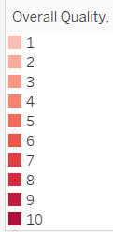
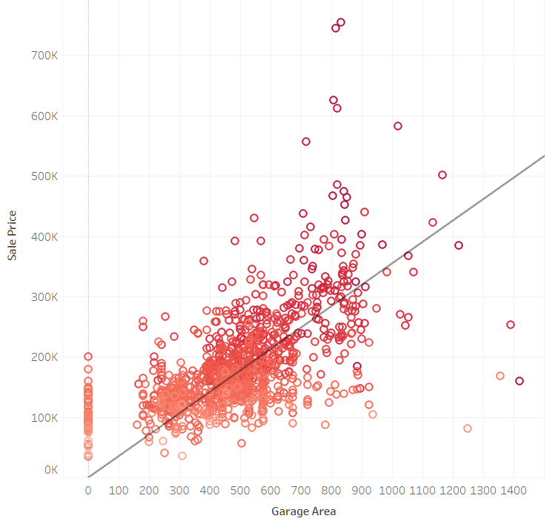
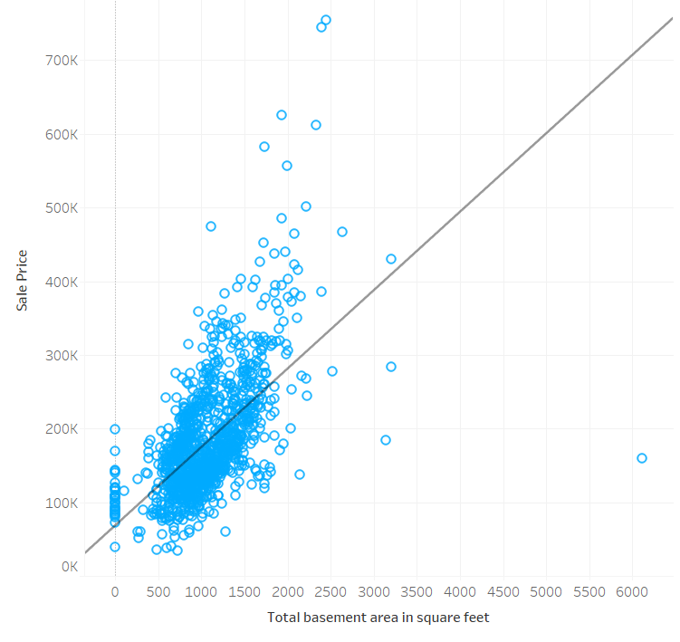
4.Garage area vs Sales Price
5. Total basement area in sq ft vs Sales Price
The garage and sales price are linearly related.
The total basement area in sq ft and sales price are
linearly related.

Slide 7
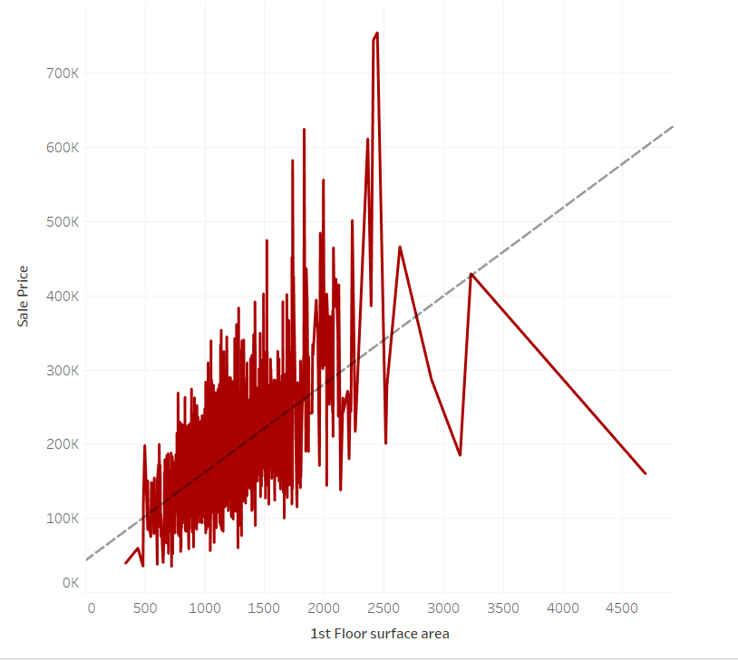
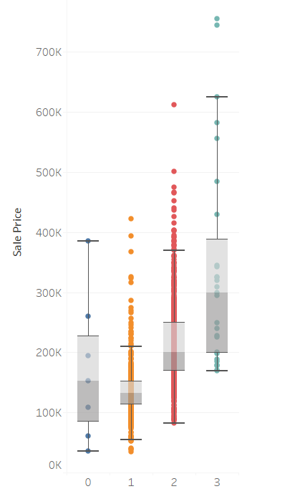
6. 1st Floor surface area vs Sales Price
7.Full bathrooms above ground vs Sales Price
There is a positive linear correlation between the 1st floor surface area and sales price.
Generally as number of full bathroom increases the sales price also going to be increased.

Slide 8
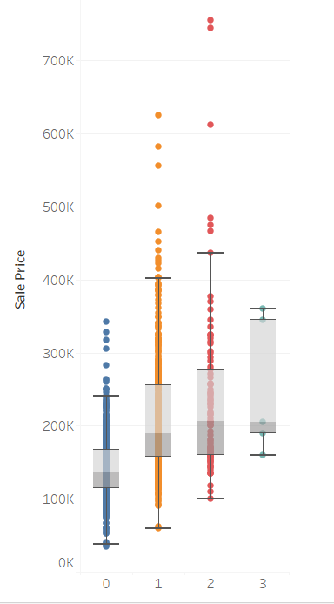
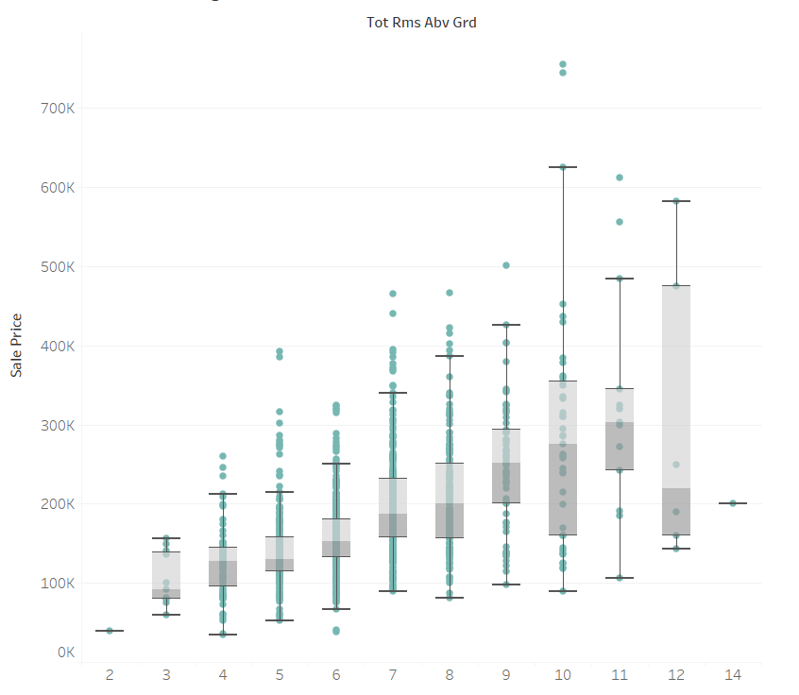
8. Total rooms above ground vs Sales Price
9.Number of fireplaces vs Sales Price
As total rooms above the ground increases sales prices also going to increase.
Generally as number of fire places increases the sales price also going to be increased.

Slide 9
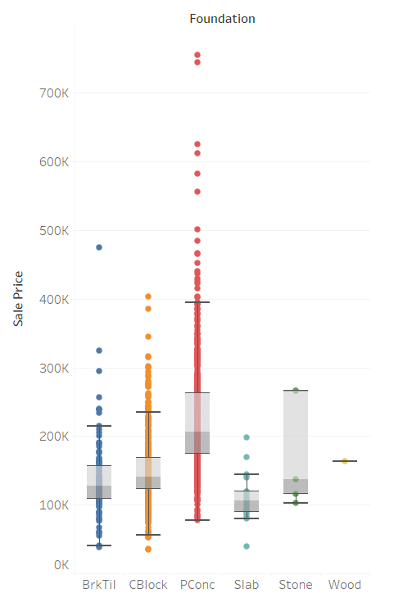
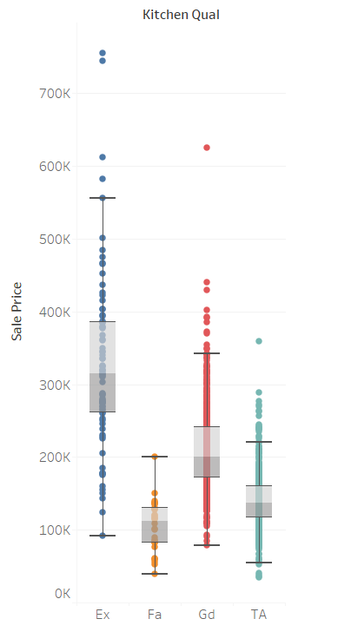
10.Type of foundation vs Sales Price
11.Kitchen quality vs Sales Price
If its poured concrete foundation then its sales price will be higher than any other type of foundation followed by Cinder block,stone,brick and tail and wood.
The excellent kitchen quality will get sold for higher price,followed by good,average/typical,fair and poor.

Slide 10
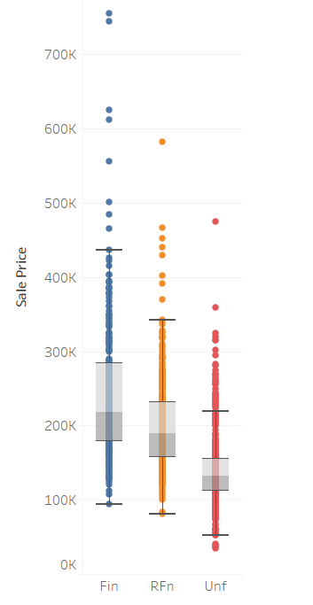
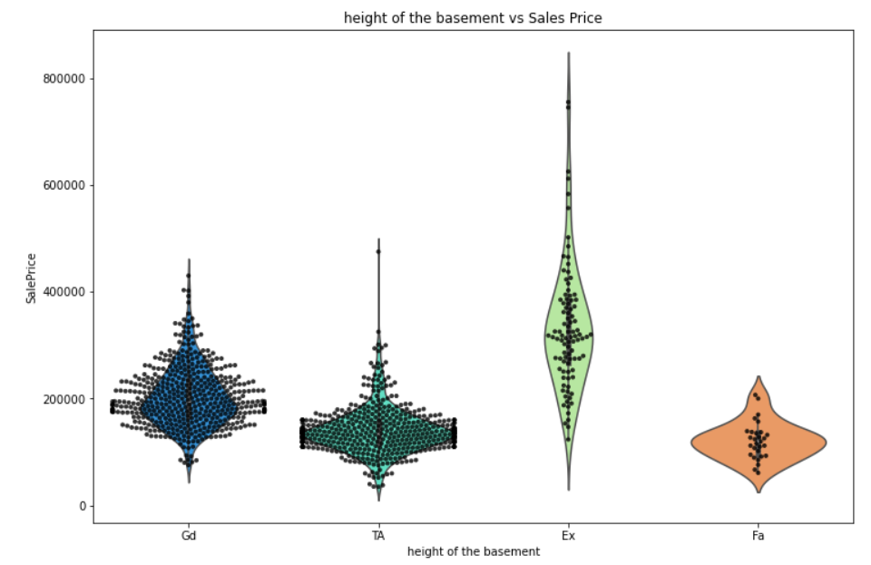
13. Evaluates the height of the basement vs Sales Price
12. Interior finish of the garage vs Sales Price
The Excellent (100+ inches) basement will get sold for significantly high price followed by Gd-Good (90-99 inches),TA-Typical (80-89 inches)
If interior of garage is finished then it will have higher sales price followed by rough finish and unfinished.

Slide 11
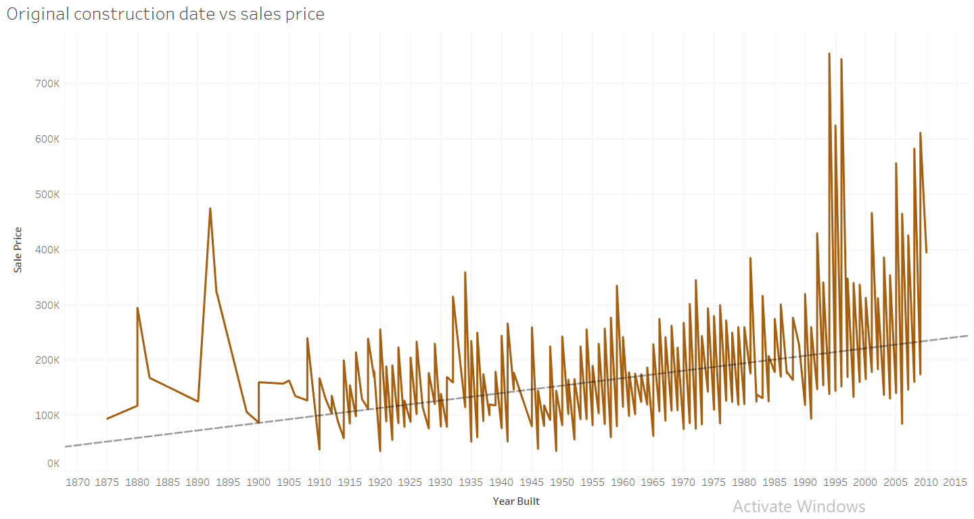
14. Year in which house was built vs Sales Price
We can see the trend that if the house was built in recent years then it will have high sales price.

Slide 12
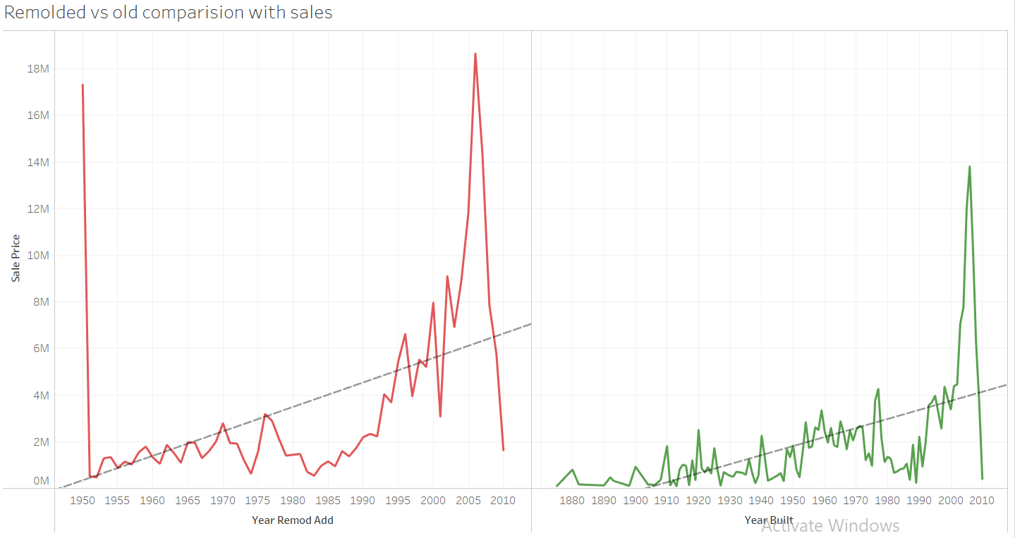
15. Comparing the remodeled and non remodeled houses against sales price
The remolded house will get sold for better price than non remolded house

Slide 13
Preparation of dataset for model building
The dataset what we are provided with contains 81 columns and most of the columns are of categorical type and there are null values in the dataset
We have to do majorly two task to prepare the dataset for model, First we have to fill the null values and after that we have to label encode it
The null values can be in categorical columns or in integer or float columns, If the null values in any columns exceeds by 63% then its better to remove entire column, If there are any null values in float columns just replace it with the median of the column and if there are any null values in the categorical column replace it with the mode of the column.
After cleaning the null values label encode all the categorical columns.

Slide 14
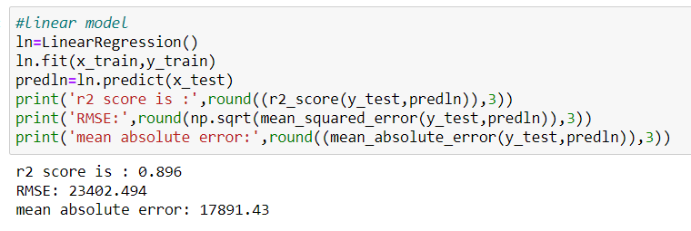
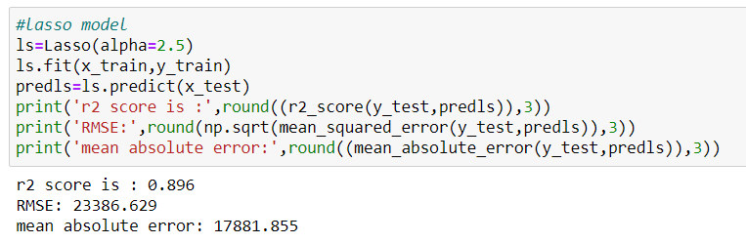
Building the model
In order to fetch the best suited model for this dataset we need to evaluate all major parameters regarding the linear regression models, we have to find the difference between cross validation score and accuracy , the least of the difference is considered as best model and we had hyper parameter tuned that.
The accuracy ,cross validation score and their difference are follows.
Linear Model
Lasso Model

Slide 15
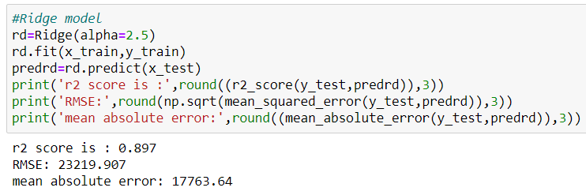
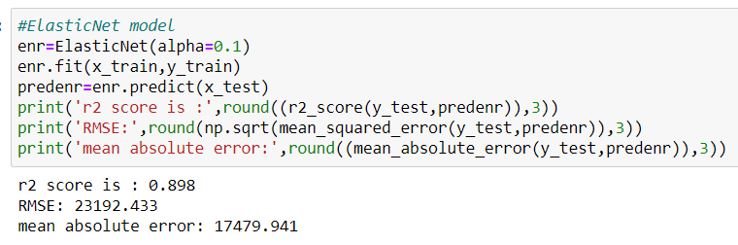
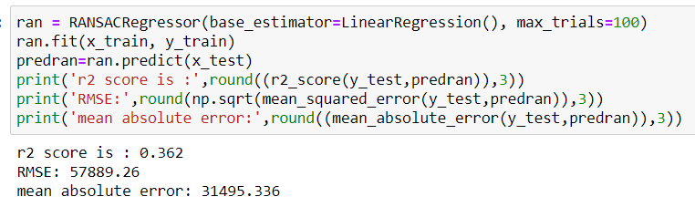
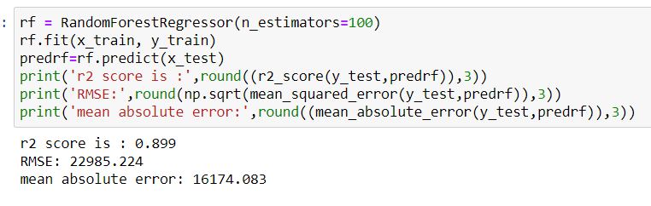

Slide 16
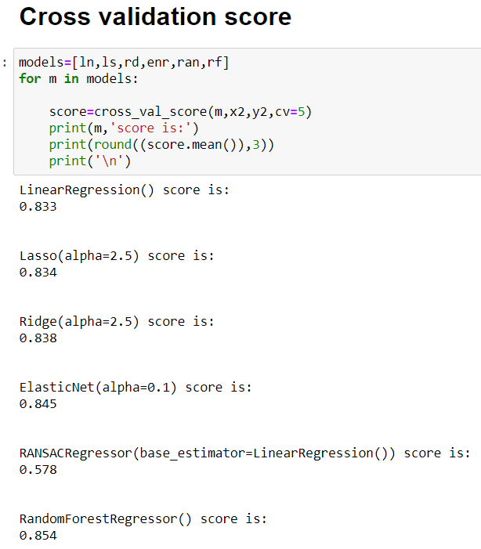
Cross Validation
Difference of cross validation
and accuracy score
Sl.No Model Name Difference
1. Linear Regression 0.063
2. Lasso regression 0.056
3. Ridge Regression 0.059
4. Elastic Net 0.053
5. RANSACRegressor -0.216
6. Random Forest 0.045
The best model among all the above is Random Forest regressor which has got the least difference of 0.045

Slide 17
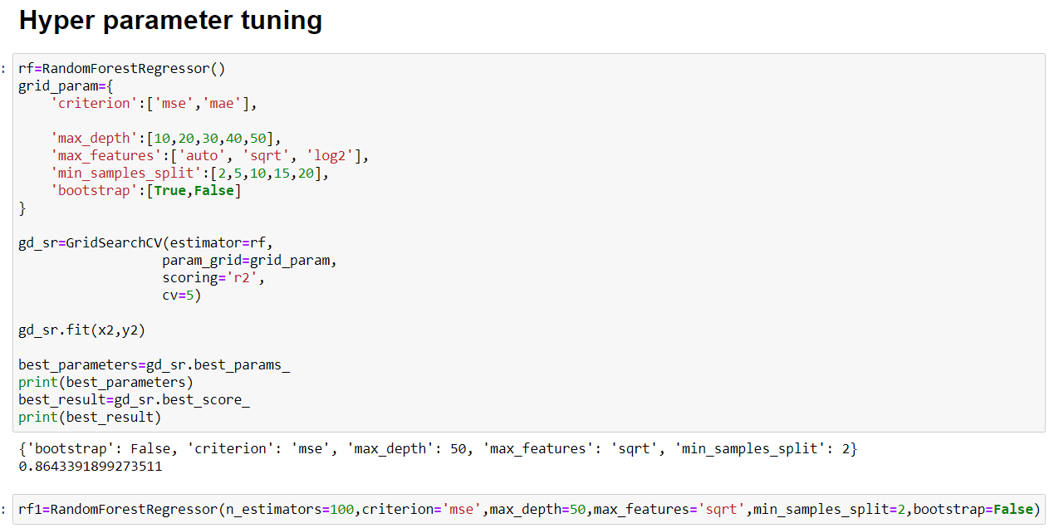
Hyper Parameter Tuning

Slide 18
Conclusion
The best model what we have got is Random Forest regressor with an accuracy of 90%
To enter into new market the above mentioned points are so cruicial and it has to be given first priority since they influence sales price in an significant manner compared to all other variables.
Thank you

